Slide 1
Let’s Talk Stocks
Advanced Level

Slide 2
Why Learn About
the Stock Market?
It is an integral part of American society
It is considered a core element of America’s economic system
Stocks & Bonds are financial products that are traded & represent companies that affect our daily lives
Stock Market- A general term used to describe the place where all transactions involving the buying and selling of stock shares issued by a company take place

Slide 3
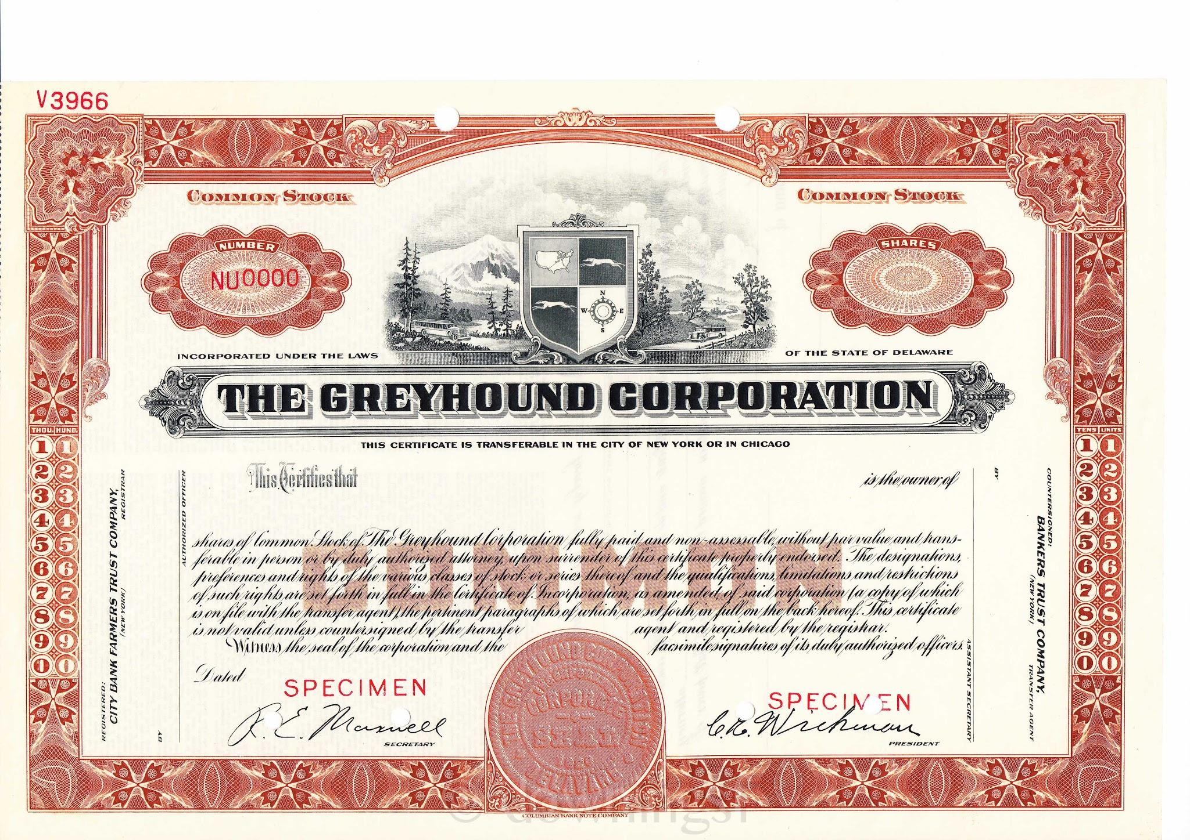
Some Basic Stock Market Terms
Stocks - a share of ownership in the assets
and earnings of a company
Stock certificate - Typically now a digital certificate provided to a shareholder representing their ownership shares of a stock(s)
Bond - type of debt that a company issues to investors for a specified amount of time; may offer a fixed rate of interest

Slide 4
Why Do Companies Issue Stocks?
When a company would like to grow or expand, it can choose to sell stocks to raise funds to pay for ongoing business activities. It is popular because:
The company does not have to repay the money
Allows for owners to make further investments using stock-frees up cash
Paying dividends is optional
What’s a Dividend? distributions of earnings paid to stockholders

Slide 5
Initial Public Offering (IPO) - the first time the stock of a private company is offered to the public to be traded on a stock exchange
Notes:
Initial Public Offering (IPO) - the first time the stock of a private company is offered to the public to be traded on a stock exchange.

Slide 6
Risk vs. Return
Risk is defined as uncertainty about an outcome
Stocks tend to offer a higher Rate of Return (increase or decrease in the original purchase price of an investment, and most often expressed as a percentage) than more liquid investment products like savings
But the trade-off is more risk with this type of investment
If an investor seeks a higher rate of return for their investment, they must be willing to accept greater risk with their money | To reduce exposure to risk, investors should create a Diversified Portfolio in which their money is invested in a variety of investment tools such as stocks and bonds

Slide 7
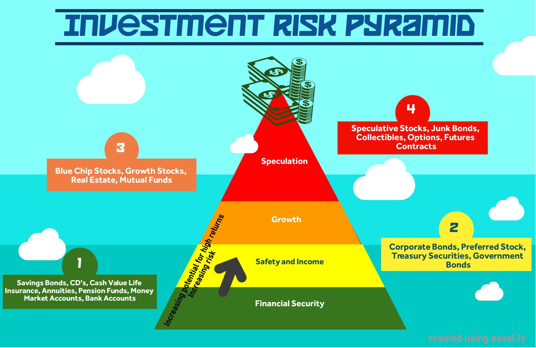
Notes:
The safer the investment, the lower the level. You should diversify your portfolio by basing your investments on Financial security and Safety & Income- Savings, Pensions, Market Accounts, Bonds, Preferred stock.Then place some in growth with speculation being the last part, and the least amount. Don’t place all your eggs in one basket!

Slide 8
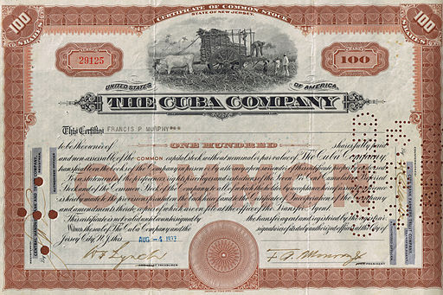
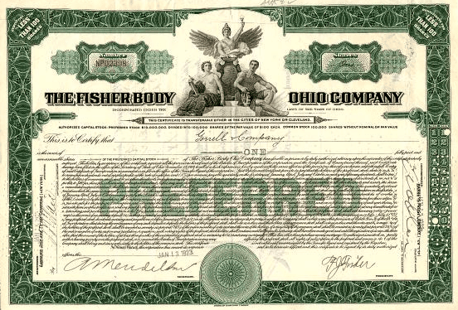
Two Basic Types of Stocks
Common
Preferred

Slide 9
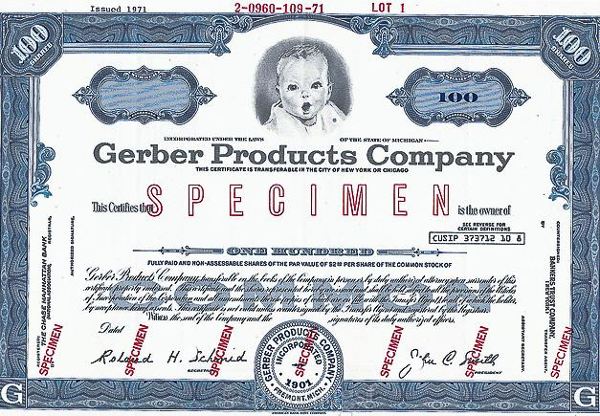
Common Stock
Common Stock – shares or units of ownership in a public corporation
Most basic form of ownership
One vote per share owned to determine company’s board of directors

Slide 10
Preferred Stock
Features
Preferred Stock - Shares which pay fixed dividends and have priority over common stock
*Less risky than common stock
*No voting rights
*Fixed value stated on the stock certificate
Stock Certificate - Usually provided as a digital certificate, shareholder receives it to represent their ownership of a stock
Dividends are stated as a percentage known as the par value or market value

Slide 11
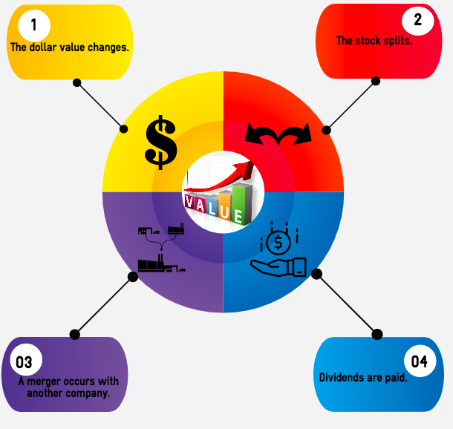
Ways Stock Values May Change
The price per share or the dollar value of the stock increases or decreases
Stock Split occurs – shares owned by existing stockholders are divided into a larger number of shares
A Merger of two companies
Dividends are paid

Slide 12
Market Price - amount a willing buyer would pay a willing seller for the stock; known as the price per stock. Based on the interest rates of the economy Par Value is the fixed value stated on a preferred stock certificate which indicates the dividends which will be paid to the shareholder.
Vocabulary Terms to Know
Example: if the Par Value is 7%, and the stock is worth $100.00, the dollar amount would be $7.00 per dividend period for each stock owned

Slide 13
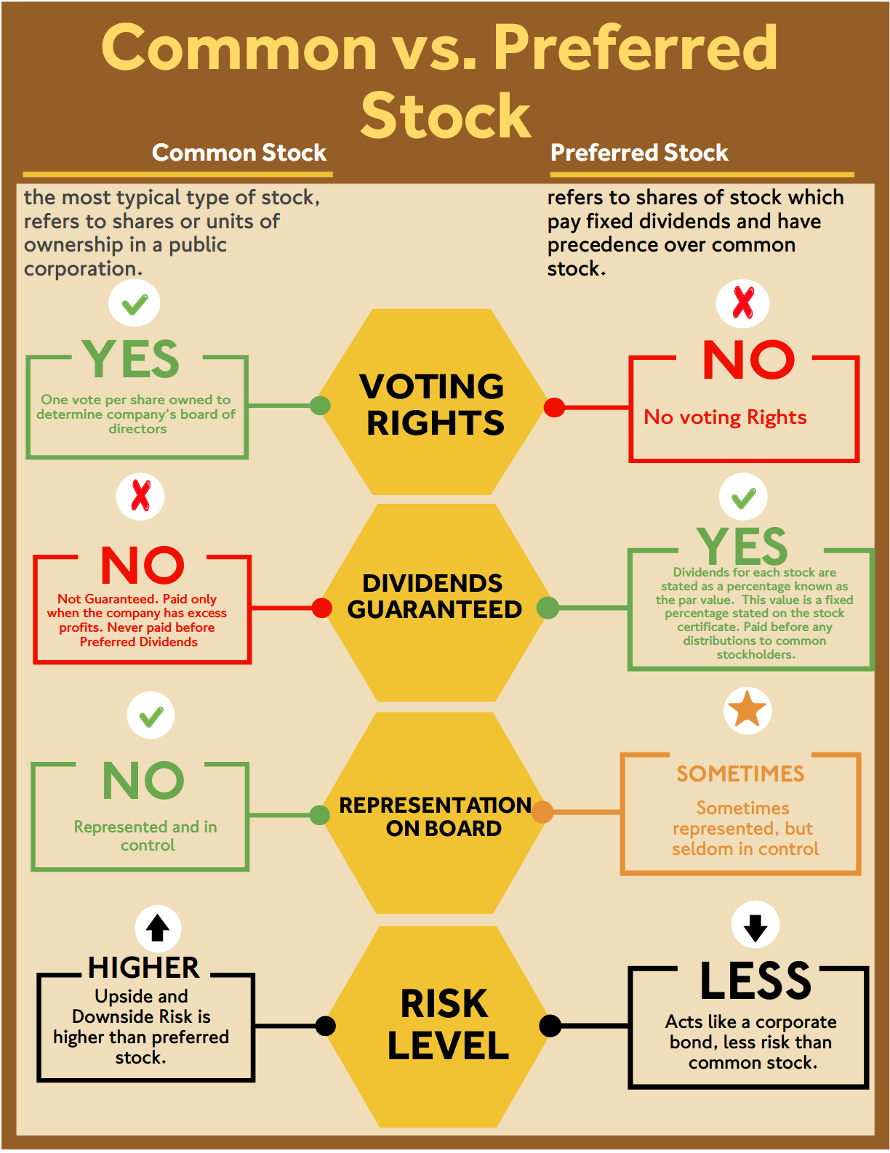
Comparing
Stocks

Slide 14
Based on the characteristics associated with the underlying company
Income
These pay high dividends because the company chooses to retain only a small portion of its profits. These stocks are from companies who have a steady stream of income. Utility companies fit this profile.
Blue Chip
From nationally recognized companies which dominate their respective industry and often have revenue of $1 billion or more. They have consistent records of profit, dividend payments, and a good reputation for company management.
Growth
A company who has a consistent record of relatively rapid growth and earnings in all economic conditions. Generally growth stocks are associated with new companies who pay no dividends to their investors.
Emerging Growth
A young firm in an emerging industry, consisting of a few companies and is often centered around a new technology. It is high risk, with great prospect for growth.

Slide 15
Based on the characteristics associated with
Cyclical
These stocks are greatly influenced by changes in the economic business cycle. They are associated with companies who operate in major consumer dependent industries such as automobiles and airlines.
Countercyclical
Also called “defensive,” these stocks are associated with companies that have consistent returns even when the economy is suffering due to the fact that their products are in high demand. Grocery stores and utility companies are examples.
Speculative
These companies have a spotty earning pattern, but have potential for substantial earnings in the future, pharmaceutical companies are represented by this type of stock. They are very high risk stocks.

Slide 16
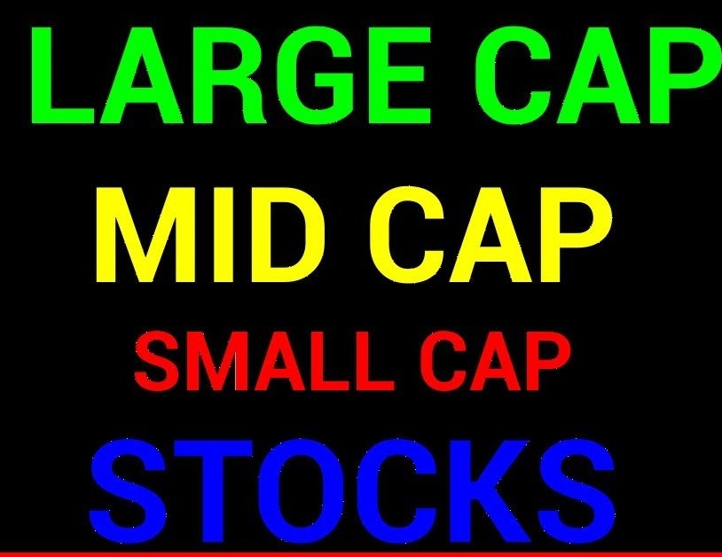
Market Value of Companies
For an investor to have a diversified stock portfolio, they must have a variety of stocks which fall into different categories and based on . . .
Characteristics associated with the underlying company
Characteristics associated with the industry
Based on the Market Capitalization (Size) of Company
Measures the size of the company
Calculated by multiplying:
number of outstanding shares X current stock price
If a company has 1.5 million shares outstanding at a share price of $25, its market cap is $37.5 million (1.5 million x $25)

Slide 17
Based on the Market Capitalization (Size) of the Company
Mega-cap
Over $200 billion
Large-cap
Over $10 billion
Mid-cap
$2 billion-$10 billion
Small-cap
$250 million-$2 billion
Micro-cap
Below $250 million
Nano-cap
Below $50 million

Slide 18
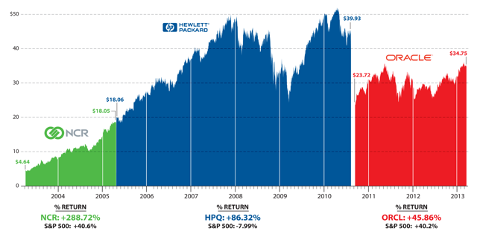
Two Ways to Analyze Stocks
Technical Analysis of Stock Trends
Studies the historical chart patterns and trends of publicly traded stocks

Slide 19
Fundamental Analysis of Stocks
Focuses on the financial statements of a company
Determines potential for future growth by analyzing
Revenue
Earnings
Return on equity
Profit margins

Slide 20
Researching a Stock
There are four numerical measures an investor may use to determine how well a company's stock is doing
Book Value
Earnings per Share (EPS)
Price/earnings ratio (P/E ratio)
Beta

Slide 21
Book Value
Formula
Assets - Liabilities = Book Value
Helps determine the net worth of a company
Calculated by subtracting a company’s liabilities from its assets, both of which can be found in the company’s annual report
The Book Value Answer indicates what would happen if a company’s assets were sold, debts paid off, and all proceeds were distributed to those who own shares of common stock

Slide 22
Earnings per share (EPS)
Formula
After tax earnings
Total number of shares
of common stock
= Earnings per share
Indicates how much income a company has available to pay in dividends or to reinvest as retained earnings on a per share basis
Highly regarded as an important statistic to consider when evaluating a stock
Determined by dividing the corporation’s after tax annual earnings (before common stock is paid but after dividends are paid to preferred stockholders) by the total number of shares of common stock

Slide 23
Price/earnings ratio (P/E ratio)
Formula
Price per share
Earnings of the stock
= P/E ratio
The relationship between the price per share of one stock and the annual earnings of the company. It represents how much investors are willing to pay for each dollar of a company’s earnings.
Most companies’ P/E Ratio is 5 to 25
Financially successful companies have a ratio of 7-10
Rapidly growing companies are between 15-25
Speculative companies are 40-50

Slide 24
Stocks with low P/E ratios pay higher dividends, have less risk, lower prices, and slow growth High P/E ratios indicate investors believe a firm is expected to have significant future growth

Slide 25
Beta
Measures a stock’s volatility compared to changes in the overall stock market
Stocks have an average beta between +0.5 - +2.0.
A negative beta indicates a countercyclical stock because the price changes are opposite the movements in the business cycle
Conservative investors want a stock with a beta of +1.0 or less meaning the stock is less sensitive to changes in the market
A beta of +1.1 - +2.0 indicates the stock is more sensitive to changes in the market because it moves at a greater percentage
A higher beta indicates a greater risk, but also the possibility of a greater reward

Slide 26
Reading a Stock Quote
Stock | YTD% | 52-Week High Low |  | DIV | YLD% | P/E | VOL 100’s | High Low |  | Close | Net Chg
AAR | -16.3 | 43 | 36 | .33 | 2.5% | 22 | 1479 | 40 | 37 | 42 | .027
Stock
YTD%
52-Week High Low
Company’s stock trading symbol name
Year-To-Date percent change. Change in price since 1/1
Highest and lowest prices the stock sold per share during last year.

Slide 27
Reading a Stock Quote
Stock | YTD% | 52-Week High Low |  | DIV | YLD% | P/E | VOL 100’s | High Low |  | Close | Net Chg
AAR | -16.3 | 43 | 36 | .33 | 2.5% | 22 | 1479 | 40 | 37 | 42 | .027
Dividends
YLD%
P/E Ratio
Total cash paid to stockholders per share. It is based upon annual payments
Dividend yield percentage is the dividend expressed as a percentage of price per share.
Price/Earnings ratio is the closing price of the share compared to the annual earnings per share.

Slide 28
Reading a Stock Quote
Stock | YTD% | 52-Week High Low |  | DIV | YLD% | P/E | VOL 100’s | High Low |  | Close | Net Chg
AAR | -16.3 | 43 | 36 | .33 | 2.5% | 22 | 1479 | 40 | 37 | 42 | .027
Vol 100’s
High Low
Close
Net Chg
The number of transactions to the share that day, represented in hundreds.
The price of the last sold share of the day.
The difference between the closing price of the share from prior day and the current day.
The high and low selling prices of the stock for the day.

Slide 29
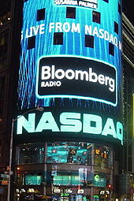
The Health of the Stock Market
There are three basic indexes which track stocks and give individuals a sense of the general health of the economy. These indexes vary daily because of the variety of stocks they measure.
The Dow Jones Industrial Average (DJIA)
The Standard & Poor’s 500 Composite Index
The NASDAQ 100 (National Association of Security Dealers Automated Quotations)

Slide 30
The Dow Jones Industrial Average originated in 1884
The oldest indicator of the ups and downs of the stock market.
Named after co-founders, Charles H. Dow & Edward Jones; nicknamed the Dow.
DJIA is the list of 30 leading industrial blue chip stocks on the NYSE www.djindexes.com

Slide 31
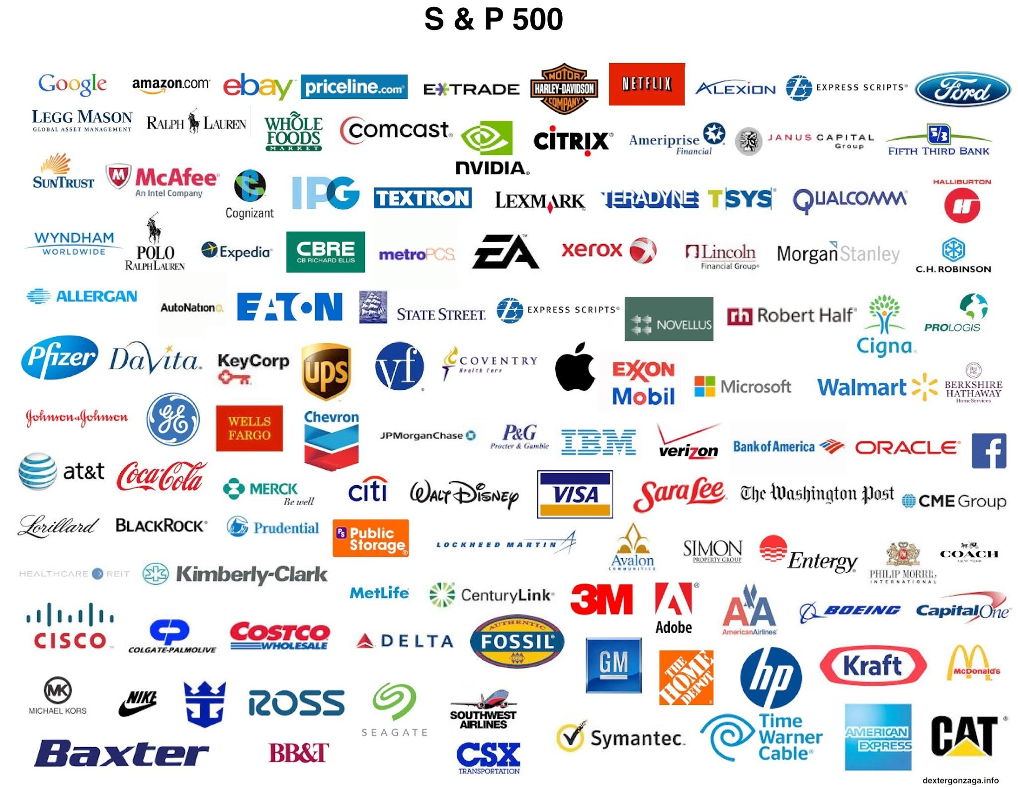
The Standard & Poor’s 500 (SP 500) Composite Index covers market activity for 500 stocks
It is more accurate than the Dow because it evaluates a greater variety of stocks www.standardandpoors.com

Slide 32
100
The NASDAQ (National Association of Security Dealers Automated Quotations) monitors fast moving technology and financial services stocks
It covers market activity for all stocks traded on the NASDAQ
NASDAQ monitors smaller companies with more speculative stock, & generally has more dramatic ups & downs
www.nasdaq.com

Slide 33
Bulls
vs.
Bears
The term bull market describes a state of the economy when prices have risen 20% or more over time.
The market’s upward trend is the result of investors who are optimistic about the economy and purchasing stocks.
A bear market describes a scenario when the market is doing poorly and investors are not confident in the economy; there are more sellers than buyers; investors hold back from purchasing stocks & selling those already owned. A bear market is characterized by a 20% decline in prices over time.

Slide 34
Organized Exchanges
Each exchange has minimum requirements for a stock to ensure only reputable companies are used. They evaluate:
annual earnings before taxes
net assets
market value
number of common shares offered to the public
number of stockholders owning 100 or more shares
Each exchange has a limited number of seats available which brokerage firms purchase to give them the legal right to buy and sell stocks on the exchange.

Slide 35
New York Stock Exchange
Began in 1792 and is the largest stock exchange by market capitalization
NYSE has the strictest company standards in order to be “listed”
There are over 2,800 companies who offer stocks on the NYSE, whose market capitalization was over $12 Billion as of 2017.
www.nyse.com

Slide 36
NASDAQ
National Assoc. of Securities Dealers Automated Quotations
Is an over-the-counter electronic stock exchange
The NASDAQ has more than 3,300 small American and foreign companies listed
The company requirements to become “listed” are not as strict as NYSE
The market capitalization for 2017 was over $21 trillion
www.nasdaq.com

Slide 37
Regional Stock Exchanges
Place to trade stocks to investors living in a specific geographical area
Can be found in major urban cities like Boston, Cincinnati, Philadelphia, Spokane, and also Intermountain, Midwest

Slide 38
International Stock Exchanges
CAC = France
DAX = Germany
FTSE = United Kingdom
Hang Seng = Hong Kong
Nikkei = Japan

Slide 39
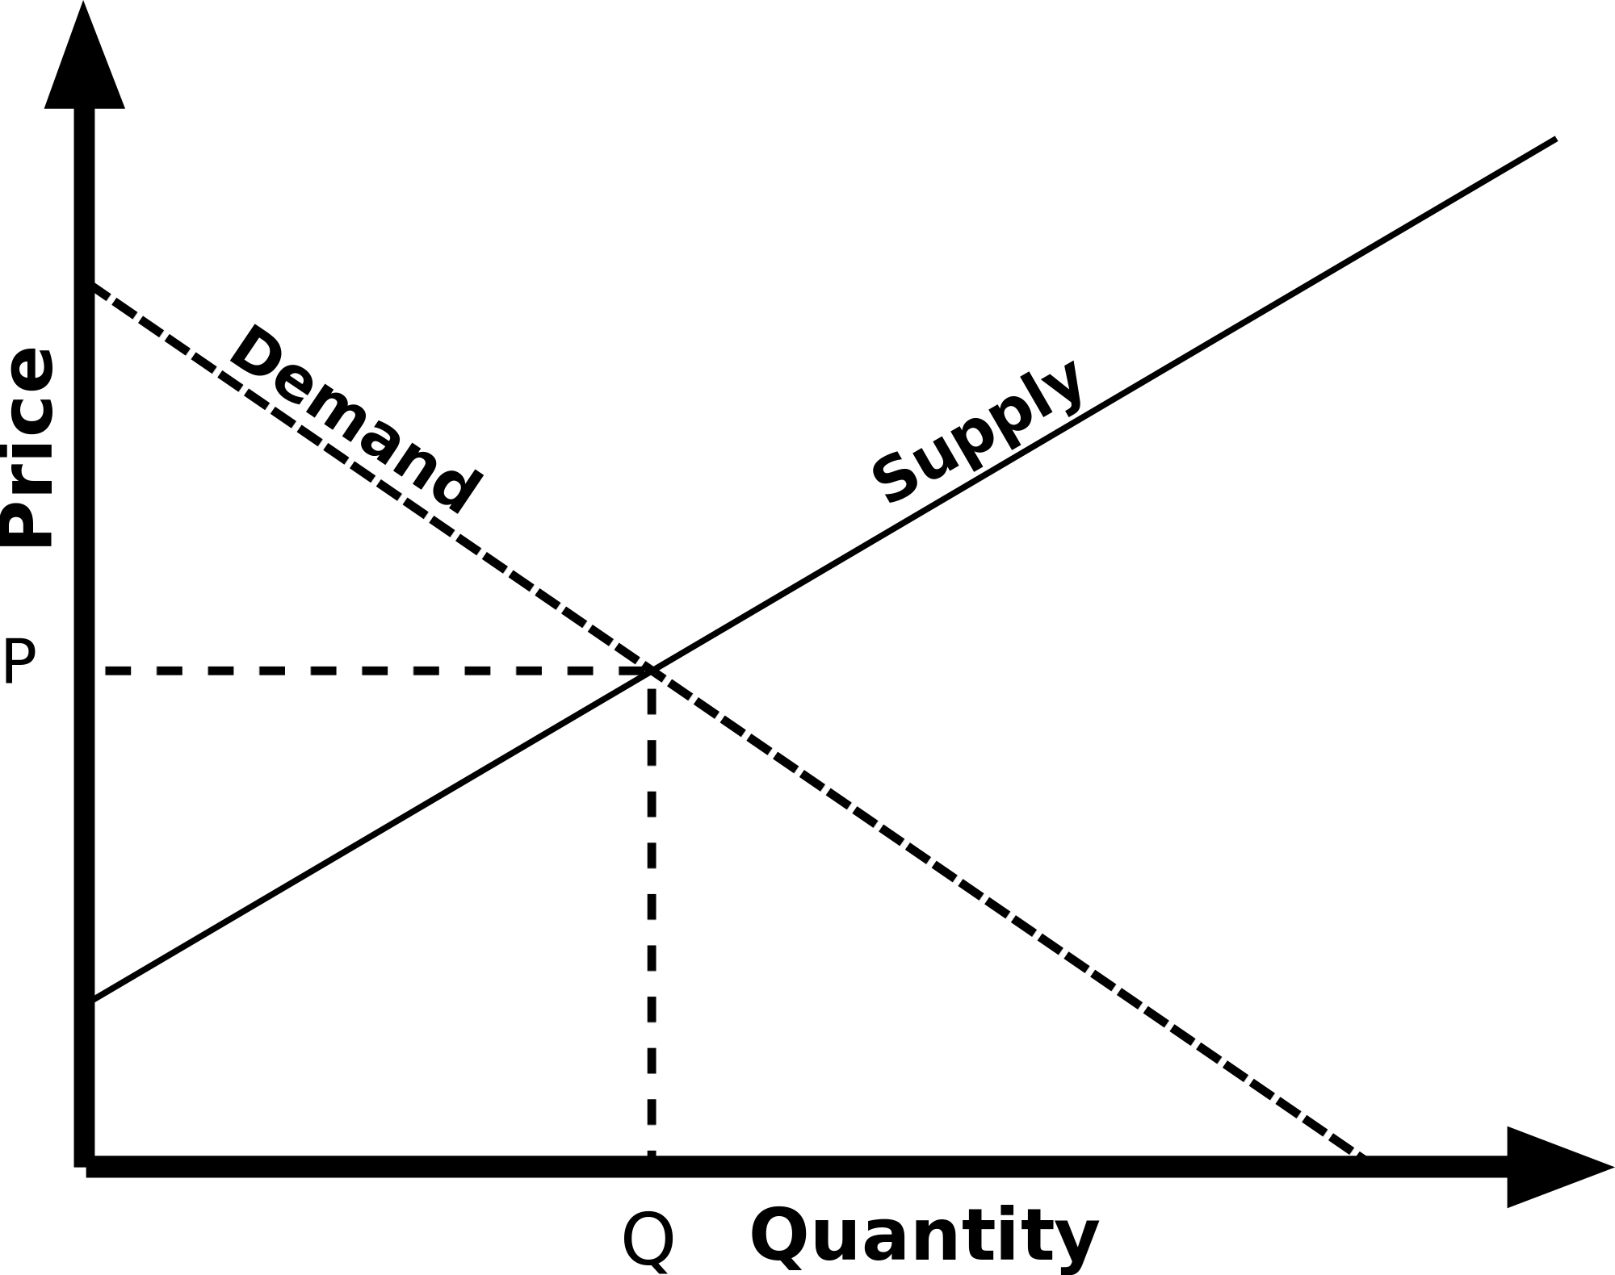
Markets are Auctions
Buyers and sellers meet to compete for best price
Based upon the laws of supply and demand
______________________________________
Supply is the relationship of prices to the quantities of a good or service sellers are willing to offer for sale at any given point in time
Demand is the relationship between prices and the corresponding quantities of a good or service buyers are willing to purchase at any given point in time
A trade occurs when the best bid meets the lowest offer to sell.

Slide 40
Buying & Selling
Investors buy and trade stock through brokers.
An investor will establish an account by depositing cash or stocks in a brokerage account.
Stocks can be bought and sold through a full service broker OR a discount brokerage, often through an online website

Slide 41
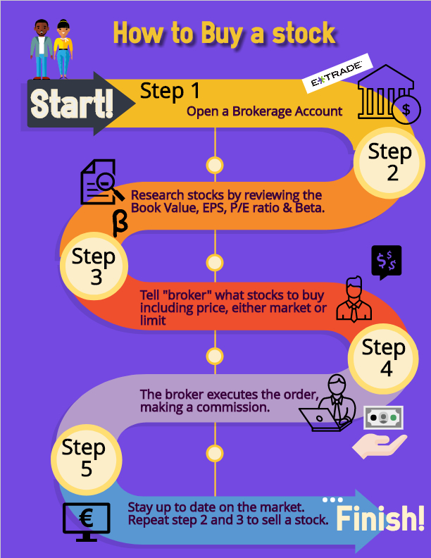
Executing Stock Transactions
A broker will execute a trade for you after telling broker how many and what types of stocks you’d like to purchase
In turn, they earn a commission
After selecting the stocks you want to purchase, you can either make a “market order” or a “limit order.”
A market order is one in which you buy stock at prevailing market price.
A limit order is when you request to buy a stock at a limited (specific) price

